Slide 1


The Internet

Slide 2

Open Sublime Text
Setup
SSID: MakeShop
Password: workshops
Go To: webdev.therobotfoundry.net
Click on “Hosting”

Slide 3
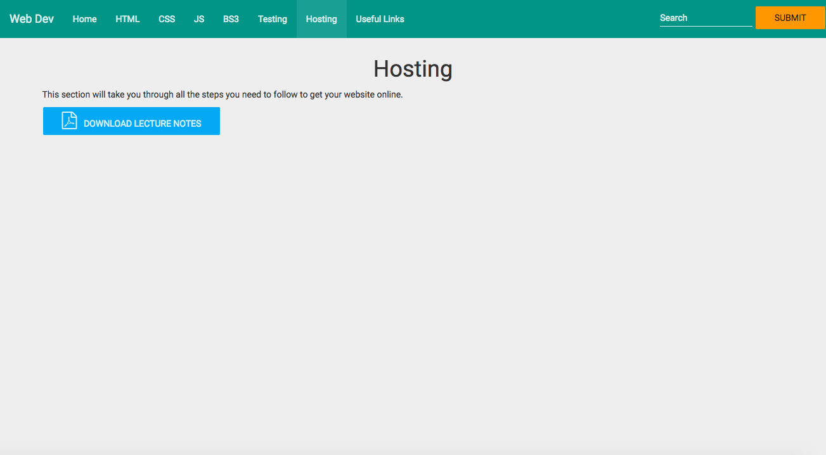
Screenshot of download page

Slide 4
Course Overview
Presentation (HTML/CSS)
Interaction (Scripts/Databases)
Hosting

Slide 5
Objective
Your website – online!

Slide 6
Method
Four Challenges:
Set up Github account (free)
Create a repo and gh-pages branch
Upload your website
Repeat

Slide 7
Github
Git: Version control software. Linus Torvalds
Github: A place to upload and manage software projects.

Slide 8
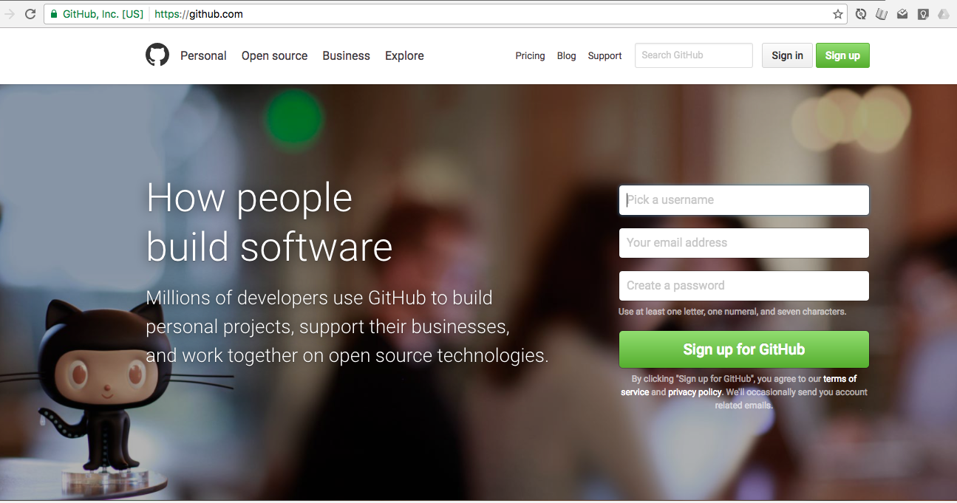
Sign Up

Slide 9
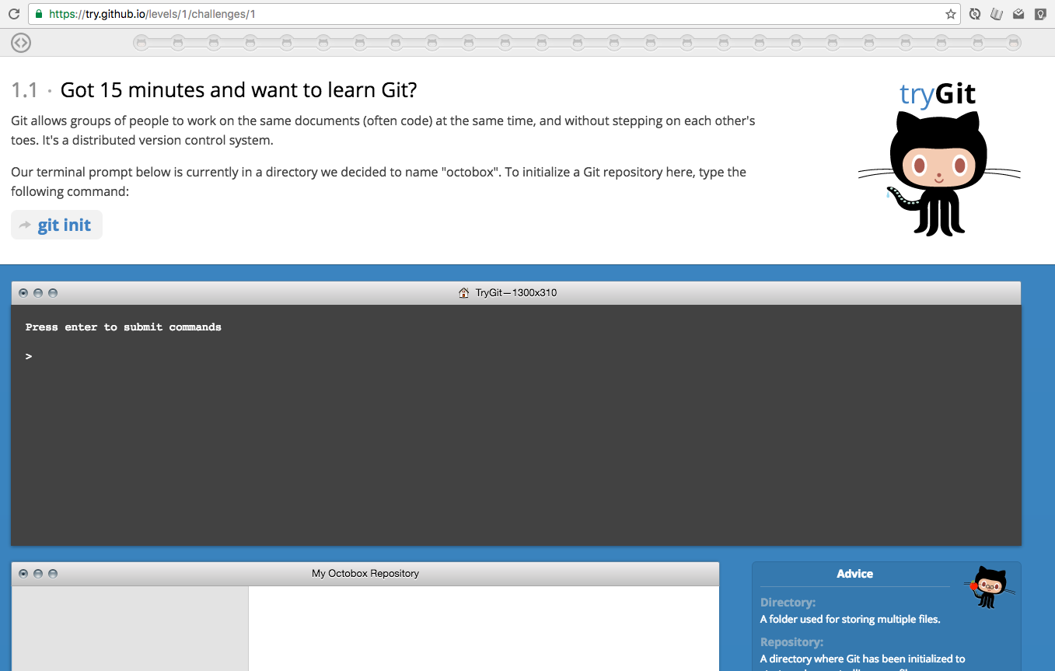
Learn More:
https://try.github.io/

Slide 10
The Internet

Slide 11
History

Slide 12
History

Slide 13
History

Slide 14
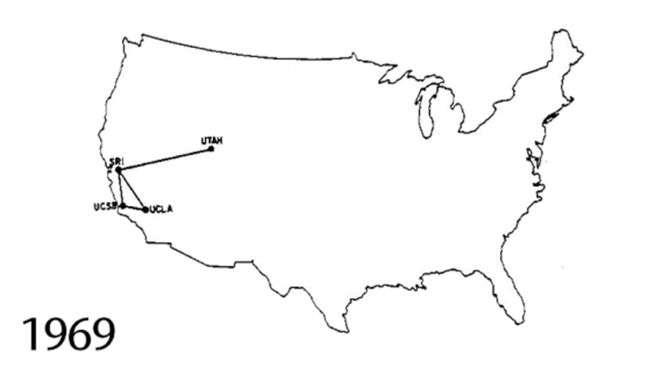
DARPANET

Slide 15
Internet
Vint Cerf
TCP/IP
MCI Mail

Slide 16
World Wide Web
Tim Berners-Lee
HTTP
HTML

Slide 17
Growth

Slide 18
Growth
http://www.submarinecablemap.com/

Slide 19
Back to Ireland

Slide 20
Data Centres

Slide 21
Servers

Slide 22
Challenge
ping
traceroute/tracert

Slide 23
Utilities
http://whatsmyip.org
http://iplocation.net

Slide 24
You.com
1. Register your domain name.
(Brand name/Company name)
2. Get Hosting
(shop/warehouse)

Slide 25
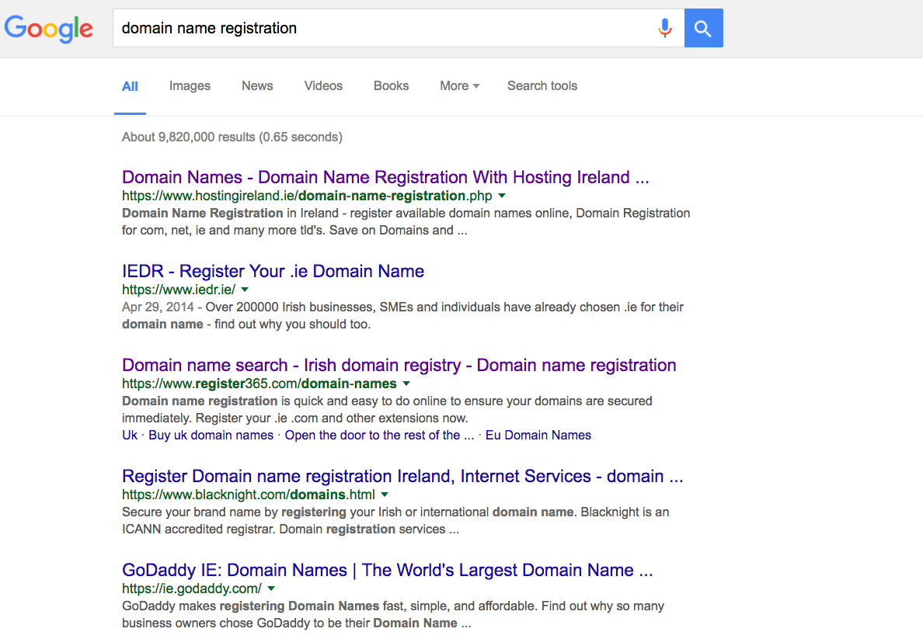
Domain Names

Slide 26
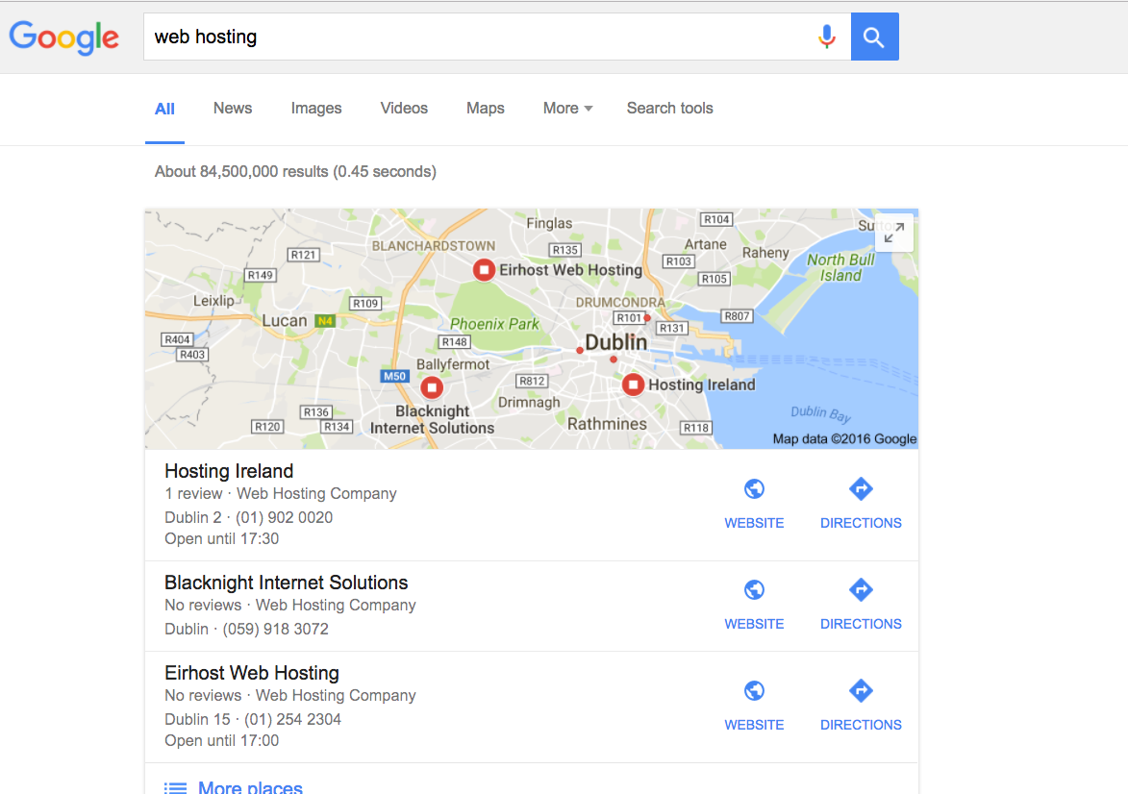
Web Hosts

Slide 27
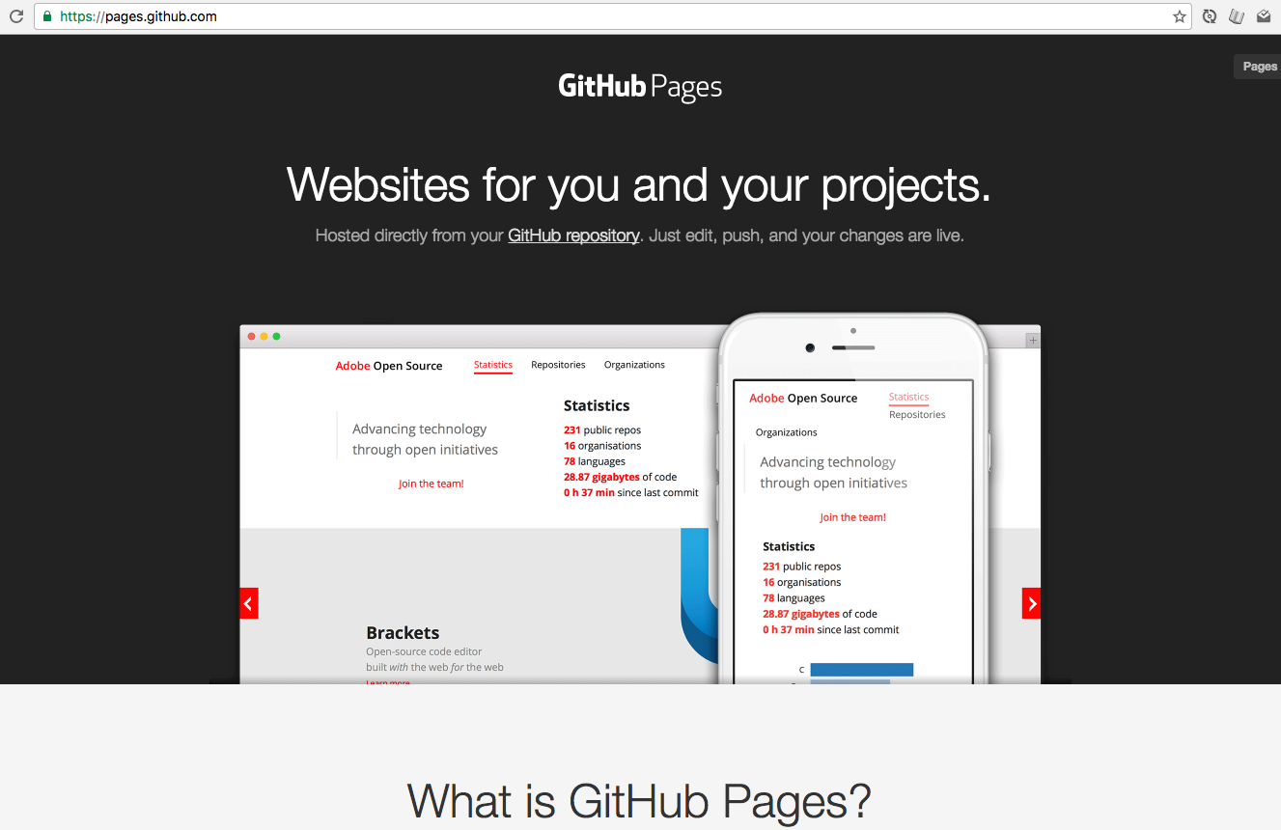
Github Pages

Slide 28
Github Address
username.github.io/repo-name
domhnallohanlon.github.io/website

Slide 29
Github Pages + Your Domain Name
CNAME
https://help.github.com/articles/setting-up-an-apex-domain/
IP Addresses (for you Registrar)
192.30.252.153
192.30.252.154

Slide 30
Other Frameworks
Bootstrap
Zurb Foundation
Semantic-UI

Slide 31
“Free” Alternatives

Slide 32
Demos
X

